Slide 1
Table Normalization
DBMS-1002

Slide 2
In These Slides . . .
We will be covering:
Database Normalization
First Normal Form (1NF)
Second Normal Form (2NF)
Third Normal Form (3NF)
Anomalies
Insertion, Deletion, Modification, Time
Dependencies
Functional, Partial, Derived, and Transitive

Slide 3
Database Design
Designing a database can be subjective.
For example: If you ask 10 database experts to create an ERD based on some complex business requirements, you will likely see 10 unique solutions.
So, how do we know if a database design is good?

Slide 4
Database Design
A well made relational database will REDUCE data redundancy and have increased data integrity.
Data Redundancy happens when values are repeated unnecessarily; such as a field value showing up on multiple rows or a column repeated in two or more tables.
Data Integrity aims to prevent unintentional changes to the information stored in our database.

Slide 5
Database Design
If not caught early in the design/development process, redundancy and integrity issues can have dramatic effects.
Poor Database Designs will lead to:
Extra storage requirements
Data Anomalies . . .
Insertion, Deletion, Modification and Time Anomalies

Slide 6
Poor Database Designs
Let’s learn what NOT to do, using a poorly designed database!
Assume the following business rules:
Employees can take up to 2 courses that will be reimbursed.
The company will not pay for the same course twice
If an employee fails a course and retakes it, the company will only pay for the first time.
The company does not record course information unless they are paying for it.

Slide 7
Poor Database Designs - Example
Here is a sample of the data in a spreadsheet:
EmpID | Name | DeptNo | Dept | Monthly Salary | Yearly Salary | Course | Date Completed | Mark | Fee
100 | Margaret | 1 | Marketing | 3,500 | 42,000 | Database | 6/19/2020 | 78 | 456
 |  |  |  |  |  | VB | 6/19/2020 | 88 | 330
140 | Nancy | 2 | Accounting | 3,250 | 39,000 | C++ | 12/8/2020 | 91 | 700
 |  |  |  |  |  | Java | 1/30/2021 | 99 | 800
110 | Chris | 3 | Info System | 3,750 | 45,000 | Database | 5/7/2020 | 53 | 456
190 | Steve | 4 | Finance | 3,200 | 38,400 | ASP | 6/19/2020 | 65 | 250
150 | Joe | 1 | Marketing | 3,200 | 38,400
Note:
Margaret has taken 2 courses: VB and Databases.
Nancy has taken 2 courses: C++ and Java.
Joe has not taken a course.
Steve and Joe have taken a single course each.

Slide 8
Poor Database Designs - Example
We want to make a table in a database to hold this info:
EmpID | Name | DeptNo | Dept | Monthly Salary | Yearly Salary | Course | Date Completed | Mark | Fee
100 | Margaret | 1 | Marketing | 3,500 | 42,000 | Database | 6/19/2020 | 78 | 456
 |  |  |  |  |  | VB | 6/19/2020 | 88 | 330
140 | Nancy | 2 | Accounting | 3,250 | 39,000 | C++ | 12/8/2020 | 91 | 700
 |  |  |  |  |  | Java | 1/30/2021 | 99 | 800
110 | Chris | 3 | Info System | 3,750 | 45,000 | Database | 5/7/2020 | 53 | 456
190 | Steve | 4 | Finance | 3,200 | 38,400 | ASP | 6/19/2020 | 65 | 250
150 | Joe | 1 | Marketing | 3,200 | 38,400
We cannot represent courses on multiple rows like this in our database.
What if we add: Course2, Date_Completed2, Mark2, Fee2 ???

Slide 9
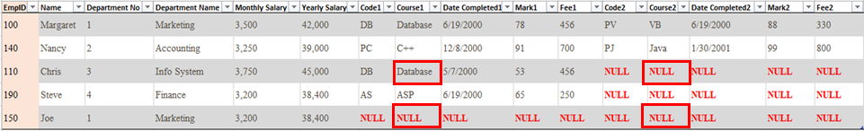
Poor Database Designs - Example
If we add columns we end up with a lot of NULL values. (All the employees with 0 or 1 course)
Another problem: What if the business decides to reimburse 3 or more courses?
What spot does it go in? We cannot do this.

Slide 10
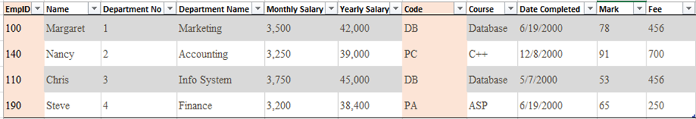
Poor Database Designs - Example
What if we make each course on it’s own row instead?
EmpID and Code could be a Composite Primary Key!
This an improvement over the previous design because there is no wasted space on each row
Each row contains a single course
However…

Slide 11
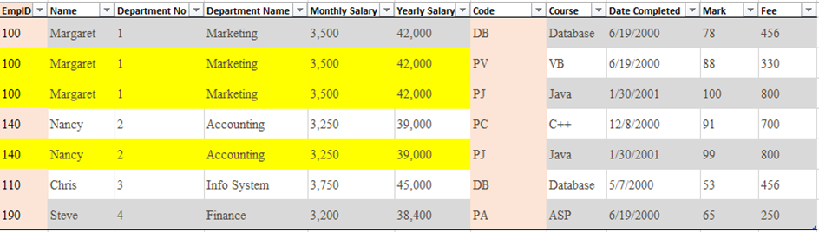
Poor Database Designs - Example
What happens when someone takes multiple courses?
The yellow cells show all the duplicated data.
This is one form of Data Redundancy!

Slide 12
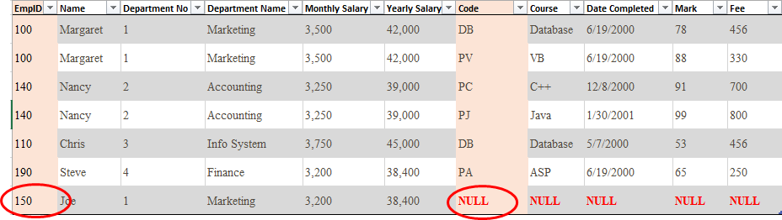
Poor Database Designs - Example
What happens when someone does not take a course?
Notice that Joe still has a lot of NULLs.
All new employees will start out this way!
The employee cannot be added to the table since the ‘Course’ part of the primary key would be NULL

Slide 13
Database Design - Anomalies
Data Anomalies occur when a user attempts to modify a table that contains redundant information.
There are three kinds of anomalies:
Insertion Anomaly
Deletion Anomaly
Modification Anomaly
The next few slides will illustrate each of these by example.

Slide 14
Database Design - Insertion Anomaly
Insertion Anomaly
Data cannot be inserted into a table without inserting data that is NOT directly related.
Example: Adding new Employees requires course information, even if it is not applicable.

Slide 15
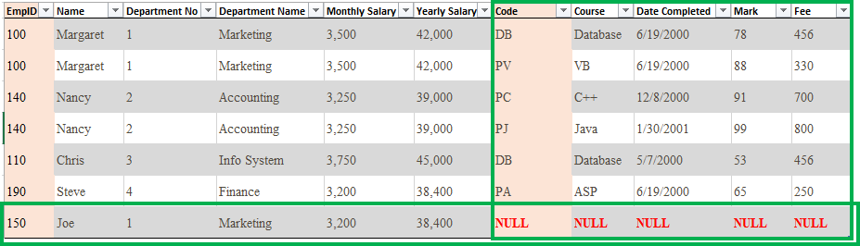
Database Design - Insertion Anomaly
Insertion Anomaly
Adding a new Employee to our table requires either course information or NULL values!
Note: Most employees will not have any courses paid for when they are hired, so this would prevent me from adding them to the database. On his hire day, Joe will get a row full of NULLs!

Slide 16
Database Design - Deletion Anomaly
Deletion Anomaly
When data is removed, other data not directly related must also be deleted.
Example: Removing course information will also remove an employee!

Slide 17
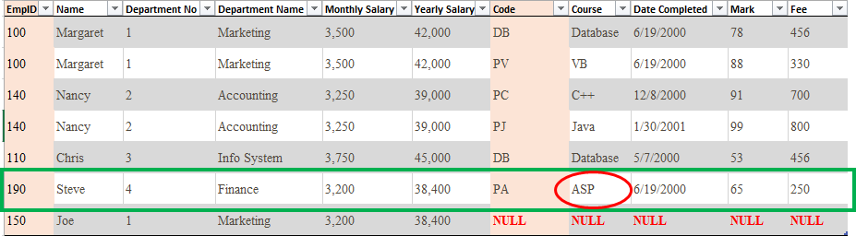
Database Design - Deletion Anomaly
Deletion Anomaly
Suppose that ASP is no longer used by the company. Management wants to delete all information regarding ASP
Removing the ASP course also removes the employee!
Poor Steve is fired because we delete ASP? :(

Slide 18
Database Design - Modification Anomaly
Modification Anomaly
Updating data requires duplicate data spread out over multiple rows to be updated at the same time for data integrity!
Example: Changing employee information may require updating multiple rows assuming they have taken 2 or more courses.

Slide 19
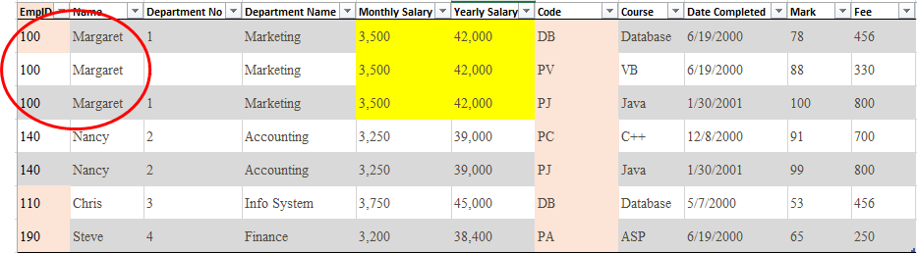
Database Design - Modification Anomaly
Modification Anomaly
To give Margaret a salary increase, we have to update THREE rows!
Imagine working on payroll when these salaries are not consistent. (Data Integrity issue!)
If they are different, can you tell which one is correct? (NO!)

Slide 20
Database Design - Redundancy
It is important to note that Data Redundancy can never truly be removed in a relational database.
Why?
Because we must relate Primary Key columns to Foreign Key columns.
Just know that these keys will always have some level of duplication throughout a database and we are ok with that.

Slide 21
Database Design
We have seen some examples of what can go wrong with a poorly designed database.
Now let us discuss a solid methodical approach to relational database design called Database Normalization.

Slide 22
Database Normalization
Database Normalization is the process of structuring relational databases to reduce data redundancy and to improve data integrity.
In this course we will discuss three stages of normalization:
First Normal Form (1NF)
Second Normal Form (2NF)
Third Normal Form (3NF)

Slide 23
Normalization - First Normal Form (1NF)
Data is in First Normal Form (1NF) if:
All attributes contain an atomic piece of information
Complex attributes may need to be broken into their own separate columns.
There exists a Primary Key
There are no Repeating Groups
Columns containing multiple values will need to move into their own table(s)

Slide 24
Normalization Example - 1NF
Starting with this spreadsheet, we will follow the steps to transform this into First Normal Form (1NF) database tables:
Attributes should all be identified by doing analysis with the users
Emp ID | Name | Dept No | Dept | Monthly Salary | Yearly Salary | Code | Course | Date Completed | Mark | Fee
100 | Margaret | 1 | Marketing | 3,500 | 42,000 | DB | Database | 6/19/2020 | 78 | 456
 |  |  |  |  |  | PV | VB | 6/19/2020 | 88 | 330
140 | Nancy | 2 | Accounting | 3,250 | 39,000 | PC | C++ | 12/8/2020 | 91 | 700
 |  |  |  |  |  | PJ | Java | 12/8/2020 | 99 | 800
110 | Chris | 3 | Info System | 3750 | 45,000 | DB | Database | 5/7/2020 | 53 | 450
190 | Steve | 4 | Finance | 3,200 | 38,400 | PA | ASP | 6/19/2020 | 65 | 250
150 | Joe | 1 | Marketing | 3,200 | 38,400

Slide 25
Normalization Example - 1NF
Step One: Break up complex attributes into new columns. (optional)
In this example we do not have to do anything.
Note: Although Date Completed is a complex attribute, we will not break it into: Day, Month, Year. (It’s not practical to do so. Unless we have a business reason for it)
If we had a Full Name, we would break it into First and Last.
Emp ID | Name | Dept No | Dept | Monthly Salary | Yearly Salary | Code | Course | Date Completed | Mark | Fee
100 | Margaret | 1 | Marketing | 3,500 | 42,000 | DB | Database | 6/19/2020 | 78 | 456
 |  |  |  |  |  | PV | VB | 6/19/2020 | 88 | 330

Slide 26
Normalization - First Normal Form (1NF)
Step Two: Declare a Primary Key
The employee id (EmpID) column is the best Primary Key candidate since each employee will have one, and they will all be different
Emp ID | Name | Dept No | Dept | Monthly Salary | Yearly Salary | Code | Course | Date Completed | Mark | Fee
100 | Margaret | 1 | Marketing | 3,500 | 42,000 | DB | Database | 6/19/2020 | 78 | 456
 |  |  |  |  |  | PV | VB | 6/19/2020 | 88 | 330
140 | Nancy | 2 | Accounting | 3,250 | 39,000 | PC | C++ | 12/8/2020 | 91 | 700
 |  |  |  |  |  | PJ | Java | 1/30/2021 | 99 | 800
110 | Chris | 3 | Info System | 3750 | 45,000 | DB | Database | 5/7/2020 | 53 | 450
190 | Steve | 4 | Finance | 3,200 | 38,400 | PA | ASP | 6/19/2020 | 65 | 250
150 | Joe | 1 | Marketing | 3,200 | 38,400

Slide 27
Normalization - First Normal Form (1NF)
Step Three - Part 1: Identify which row(s) contain multiple values
Often referred to as a Repeating Group is any attribute or group of attributes that occur more than one time on a single row (multiple-value attributes)
For example: Code
Has a set of 2 values for employee id 100: [DB, PV]
Therefore the columns that can contain multiple values per row are: Code, Course, Date Completed, Mark, Fee
Emp ID | Name | Dept No | Dept | Monthly Salary | Yearly Salary | Code | Course | Date Completed | Mark | Fee
100 | Margaret | 1 | Marketing | 3,500 | 42,000 | DB | Database | 6/19/2020 | 78 | 456
 |  |  |  |  |  | PV | VB | 6/19/2020 | 88 | 330
140 | Nancy | 2 | Accounting | 3,250 | 39,000 | PC | C++ | 12/8/2020 | 91 | 700
 |  |  |  |  |  | PJ | Java | 1/30/2021 | 99 | 800
110 | Chris | 3 | Info System | 3750 | 45,000 | DB | Database | 5/7/2020 | 53 | 450
190 | Steve | 4 | Finance | 3,200 | 38,400 | PA | ASP | 6/19/2020 | 65 | 250
150 | Joe | 1 | Marketing | 3,200 | 38,400

Slide 28
Normalization - First Normal Form (1NF)
Alternatively, we could have visualized our data like this (with employee information repeated on each row):
In this case, you would have to determine which columns contained sets, by checking if values changed over multiple rows.
Emp ID | Name | Dept No | Dept | Monthly Salary | Yearly Salary | Code | Course | Date Completed | Mark | Fee
100 | Margaret | 1 | Marketing | 3,500 | 42,000 | DB | Database | 6/19/2020 | 78 | 456
100 | Margaret | 1 | Marketing | 3,500 | 42,000 | PV | VB | 6/19/2020 | 88 | 330
140 | Nancy | 2 | Accounting | 3,250 | 39,000 | PC | C++ | 12/8/2020 | 91 | 700
140 | Nancy | 2 | Accounting | 3,250 | 39,000 | PJ | Java | 1/30/2021 | 99 | 800
110 | Chris | 3 | Info System | 3750 | 45,000 | DB | Database | 5/7/2020 | 53 | 450
190 | Steve | 4 | Finance | 3,200 | 38,400 | PA | ASP | 6/19/2020 | 65 | 250
150 | Joe | 1 | Marketing | 3,200 | 38,400

Slide 29
Normalization - First Normal Form (1NF)
Step Three - Part 2: Move the columns with sets (Repeating Group) to a new table
We now have two tables: Employees and Courses
Are they both in 1NF yet?
Not yet, the new table needs a Primary Key!
Emp ID | Name | Dept No | Dept | Monthly Salary | Yearly Salary
100 | Margaret | 1 | Marketing | 3,500 | 42,000
140 | Nancy | 2 | Accounting | 3,250 | 39,000
110 | Chris | 3 | Info System | 3750 | 45,000
190 | Steve | 4 | Finance | 3,200 | 38,400
150 | Joe | 1 | Marketing | 3,200 | 38,400
Code | Course | Date Completed | Mark | Fee
DB | Database | 6/19/2020 | 78 | 456
PV | VB | 6/19/2020 | 88 | 330
PC | C++ | 12/8/2020 | 91 | 700
PJ | Java | 1/30/2021 | 99 | 800
DB | Database | 5/7/2020 | 53 | 450
PA | ASP | 6/19/2020 | 65 | 250

Slide 30
Normalization - First Normal Form (1NF)
Can we make the Code column the Primary Key?
Unfortunately, Codes are not unique.
Notice that DB is represented twice!
Which brings up a problem, how do we know who took these courses?
Code | Course | Date Completed | Mark | Fee
DB | Database | 6/19/2020 | 78 | 456
PV | VB | 6/19/2020 | 88 | 330
PC | C++ | 12/8/2020 | 91 | 700
PJ | Java | 1/30/2021 | 99 | 800
DB | Database | 5/7/2020 | 53 | 450
PA | ASP | 6/19/2020 | 65 | 250

Slide 31
Normalization - First Normal Form (1NF)
We need to add back in the Employee ID
With the addition of this column we can see which employee took which course.
Can Emp ID be the Primary Key?
No, these values are repeating too.
Emp ID | Code | Course | Date Completed | Mark | Fee
100 | DB | Database | 6/19/2020 | 78 | 456
100 | PV | VB | 6/19/2020 | 88 | 330
140 | PC | C++ | 12/8/2020 | 91 | 700
140 | PJ | Java | 1/30/2021 | 99 | 800
110 | DB | Database | 5/7/2020 | 53 | 450
190 | PA | ASP | 6/19/2020 | 65 | 250
We will need either a Composite Key or a Surrogate Key.
Notes:
What kind of relationship is Employees and Courses? MANY-TO-MANY!

Slide 32
Normalization - First Normal Form (1NF)
We are now in First Normal Form (1NF)!
Emp ID | Name | Dept No | Dept | Monthly Salary | Yearly Salary
100 | Margaret | 1 | Marketing | 3,500 | 42,000
140 | Nancy | 2 | Accounting | 3,250 | 39,000
110 | Chris | 3 | Info System | 3750 | 45,000
190 | Steve | 4 | Finance | 3,200 | 38,400
150 | Joe | 1 | Marketing | 3,200 | 38,400
Emp ID | Code | Course | Date Completed | Mark | Fee
100 | DB | Database | 6/19/2020 | 78 | 456
100 | PV | VB | 6/19/2020 | 88 | 330
140 | PC | C++ | 12/8/2020 | 91 | 700
140 | PJ | Java | 1/30/2021 | 99 | 800
110 | DB | Database | 5/7/2020 | 53 | 450
190 | PA | ASP | 6/19/2020 | 65 | 250
Note: Emp ID on the Course table is now also a Foreign Key back to the Employee table.
A Parent/Child relationship results
This data redundancy is required so the data can be put back together again

Slide 33
Normalization - Second Normal Form (2NF)
Data is in Second Normal Form (2NF) if:
It is in first normal form and …
All non-key attributes do not have a partial functional dependency on the Composite Primary Key
We will move these columns to their own tables

Slide 34
Normalization - Second Normal Form (2NF)
Three definitions are required before we continue
Non-key attributes/Keyed attributes
Functional Dependencies
Partial Functional Dependencies

Slide 35
Keyed Attributes vs Non-Key Attributes
Keyed attributes are either:
Foreign Key columns
Primary Keys columns
Non-key attributes are all other columns.

Slide 36
Functional Dependency
Functional Dependency: Within the same table, if one column can be determined by another column, it is said to be functionally dependent.
Example: We can determine the First Name of a student by looking them up with their Student Id Number.
Therefore First Name is Functionally Dependent on student ID.
This means one of the columns is a Primary Key Candidate!

Slide 37
Partial Functional Dependency
Partial Functional Dependency: Within the same table, if a non-key column can be determined by only one column of a composite primary key, it is said to be partially functionally dependent.
Let’s use a simple example to elaborate:
Employees can lease Vehicles.
Employee ID | Vehicle Number | Employee Name | Model Name | Lease Date
256 | 5589875 | John | Chev | 2012-11-12
256 | 7991231 | John | Dodge | 2020-10-31
335 | 66986741 | Sue | Ford | 2013-02-01

Slide 38
Partial Functional Dependency
The Non-key columns are:
Employee Name, Model Name and Lease Date.
Employee Name: is determined by the employee id only.
Model Name: is determined by the vehicle number only.
Lease Date: is determined by both. (Who leased what car)
Employee ID | Vehicle Number | Employee Name | Model Name | Lease Date
256 | 5589875 | John | Chev | 2012-11-12
256 | 7991231 | John | Dodge | 2020-10-31
335 | 66986741 | Sue | Ford | 2013-02-01

Slide 39
Partial Functional Dependency
To resolve Partial Functional Dependencies, we move the Non-key columns and place them in a NEW table with their dependent keyed attribute(s).
Employee ID | Vehicle Number | Lease Date
256 | 5589875 | 2012-11-12
335 | 66986741 | 2013-02-01
Note: The Composite Keys are now Foreign Keys as well.
Employee ID | Employee Name
256 | John
335 | Sue
Vehicle Number | Model Name
5589875 | Chev
66986741 | Ford

Slide 40
Normalization - Second Normal Form (2NF)
Back to our example, are these groups in second normal form?
Note: Employees (left) is already in 2NF because it does not have a composite key!
So let’s check out the right grouping….
Emp ID | Name | Dept No | Dept | Monthly Salary | Yearly Salary
100 | Margaret | 1 | Marketing | 3,500 | 42,000
140 | Nancy | 2 | Accounting | 3,250 | 39,000
110 | Chris | 3 | Info System | 3750 | 45,000
190 | Steve | 4 | Finance | 3,200 | 38,400
150 | Joe | 1 | Marketing | 3,200 | 38,400
Emp ID | Code | Course | Date Completed | Mark | Fee
100 | DB | Database | 6/19/2020 | 78 | 456
100 | PV | VB | 6/19/2020 | 88 | 330
140 | PC | C++ | 12/8/2020 | 91 | 700
140 | PJ | Java | 1/30/2021 | 99 | 800
110 | DB | Database | 5/7/2020 | 53 | 450
190 | PA | ASP | 6/19/2020 | 65 | 250

Slide 41
Normalization - Second Normal Form (2NF)
Let’s list each of the non-key attributes and see if there are any Partial Functional Dependencies on the composite keys:
Course:
Is directly related to Code.
Example:
‘Database’ is related to ‘DB’
Date Completed, Mark, and Fee:
Are all related to BOTH EmpID and Code.
Emp ID | Code | Course | Date Completed | Mark | Fee
100 | DB | Database | 6/19/2020 | 78 | 456
100 | PV | VB | 6/19/2020 | 88 | 330
140 | PC | C++ | 12/8/2020 | 91 | 700
140 | PJ | Java | 1/30/2021 | 99 | 800
110 | DB | Database | 5/7/2020 | 53 | 450
190 | PA | ASP | 6/19/2020 | 65 | 250
Notes:
The value: “Database” is not directly related to Emp ID

Slide 42
Normalization - Second Normal Form (2NF)
Why are Date Completed, Mark, and Fee related to both EmpID and Code and not just partially?
Let’s ask ourselves what a Mark means in context of key column?
Code | Mark
DB | 78
A Mark in a DB course, but whose Mark?
Emp ID | Mark
100 | 78
Employee 100’s Mark, but for which course?
Employee 100’s Mark in the DB course!
(We need BOTH keys)
Emp ID | Code | Mark
100 | DB | 78

Slide 43
Normalization - Second Normal Form (2NF)
Take the Non-key Column(s) and their Dependent Partial key column and place them in their own table(s).
Important: Remove any duplicate rows in the new table!
Declare a Primary Key column for the new table. (Code)
Code | Course
DB | Database
PV | VB
PC | C++
PJ | Java
DB | Database
PA | ASP
Code | Course
DB | Database
PV | VB
PC | C++
PJ | Java
PA | ASP

Slide 44
Normalization - Second Normal Form (2NF)
Take the non-key column(s) related to the partial key column and place them in their own table(s).
In this grouping, Course is removed from the original grouping
Code becomes a Foreign Key pointing to the new table.
Emp ID | Code | Date Completed | Mark | Fee
100 | DB | 6/19/2020 | 78 | 456
100 | PV | 6/19/2020 | 88 | 330
140 | PC | 12/8/2020 | 91 | 700
140 | PJ | 1/30/2021 | 99 | 800
110 | DB | 5/7/2020 | 53 | 450
190 | PA | 6/19/2020 | 65 | 250
Code | Course
DB | Database
PV | VB
PC | C++
PJ | Java
PA | ASP

Slide 45
Normalization - Second Normal Form (2NF)
Are we in Second Normal Form on all three tables?
YES!
Emp ID | Name | Dept No | Dept | Monthly Salary | Yearly Salary
100 | Margaret | 1 | Marketing | 3,500 | 42,000
140 | Nancy | 2 | Accounting | 3,250 | 39,000
110 | Chris | 3 | Info System | 3750 | 45,000
190 | Steve | 4 | Finance | 3,200 | 38,400
150 | Joe | 1 | Marketing | 3,200 | 38,400
Emp ID | Code | Date Completed | Mark | Fee
100 | DB | 6/19/2020 | 78 | 456
100 | PV | 6/19/2020 | 88 | 330
140 | PC | 12/8/2020 | 91 | 700
140 | PJ | 1/30/2021 | 99 | 800
110 | DB | 5/7/2020 | 53 | 450
190 | PA | 6/19/2020 | 65 | 250
Code | Course
DB | Database
PV | VB
PC | C++
PJ | Java
PA | ASP
NOTE: Tables without Composite Keys are already in 2NF if they are in 1NF.

Slide 46
Normalization - Third Normal Form (3NF)
Data is in Third Normal Form (3NF) if:
It is in second normal form and …
There are no attributes with Derived Dependencies
There are no Transitive Dependencies
We will move these columns to their own table(s)

Slide 47
Normalization - Third Normal Form (3NF)
Two definitions are required before we continue with 3NF:
Derived Dependency (Calculated)
Transitive Dependency

Slide 48
Derived Dependency (Calculated)
Derived Dependency: A Non-key column that can be calculated using other columns (from any table) is derived.
Example: age Calculated by subtracting your birth date from today’s date.
Example: total_employees
Calculated by counting rows in the Employees table.

Slide 49
Transitive Dependency
Transitive Dependency: A table has a Transitive Dependency if one or more non-key attribute(s) depend on another non-key attribute (in the same data group).
A Transitive Dependency is when a Non-key attribute depends on another Non-key attribute in the same table.
In order to have a transitive dependency, there must be at least two non-key attributes in a table.

Slide 50
Normalization - 3NF - Derived Dependency
Step 1: Remove Derived Dependencies from all tables
Yearly Salary can be calculated with: Monthly Salary * 12
When identified:
Note the exact formula required to get the data back again
Remove the derived column from the data grouping
Emp ID | Name | Dept No | Dept | Monthly Salary | Yearly Salary
100 | Margaret | 1 | Marketing | 3,500 | 42,000
140 | Nancy | 2 | Accounting | 3,250 | 39,000
110 | Chris | 3 | Info System | 3750 | 45,000
190 | Steve | 4 | Finance | 3,200 | 38,400
150 | Joe | 1 | Marketing | 3,200 | 38,400

Slide 51
Normalization - 3NF - Derived Dependency
Check the other tables for Derived Dependencies...
Are any of these derived?
Emp ID | Name | Dept No | Dept | Monthly Salary
100 | Margaret | 1 | Marketing | 3,500
140 | Nancy | 2 | Accounting | 3,250
110 | Chris | 3 | Info System | 3750
190 | Steve | 4 | Finance | 3,200
150 | Joe | 1 | Marketing | 3,200
Code | Course
DB | Database
PV | VB
PC | C++
PJ | Java
PA | ASP
Emp ID | Code | Date Completed | Mark | Fee
100 | DB | 6/19/2020 | 78 | 456
100 | PV | 6/19/2020 | 88 | 330
140 | PC | 12/8/2020 | 91 | 700
140 | PJ | 1/30/2021 | 99 | 800
110 | DB | 5/7/2020 | 53 | 450
190 | PA | 6/19/2020 | 65 | 250
Notes:
Nope! No derived columns left!

Slide 52
Normalization - 3NF - Transitive Dependency
Step 2: Check for Transitive Dependencies in all tables
Remember: A Transitive Dependency is when a Non-key attribute depends on another Non-key attribute in the same table.
We can skip the middle table, because we need at least 2 or more Non-key attributes!
Emp ID | Name | Dept No | Dept | Monthly Salary
100 | Margaret | 1 | Marketing | 3,500
140 | Nancy | 2 | Accounting | 3,250
110 | Chris | 3 | Info System | 3750
190 | Steve | 4 | Finance | 3,200
150 | Joe | 1 | Marketing | 3,200
Code | Course
DB | Database
PV | VB
PC | C++
PJ | Java
PA | ASP
Emp ID | Code | Date Completed | Mark | Fee
100 | DB | 6/19/2020 | 78 | 456
100 | PV | 6/19/2020 | 88 | 330
140 | PC | 12/8/2020 | 91 | 700
140 | PJ | 1/30/2021 | 99 | 800
110 | DB | 5/7/2020 | 53 | 450
190 | PA | 6/19/2020 | 65 | 250

Slide 53
Normalization - 3NF - Transitive Dependency
Step 2: Check for Transitive Dependencies in all tables
The non-key columns are:
Date Completed, Mark and Fee
These attributes do not have dependencies on one other.
Therefore, there are no transitive dependencies.
Emp ID | Code | Date Completed | Mark | Fee
100 | DB | 6/19/2020 | 78 | 456
100 | PV | 6/19/2020 | 88 | 330
140 | PC | 12/8/2020 | 91 | 700
140 | PJ | 1/30/2021 | 99 | 800
110 | DB | 5/7/2020 | 53 | 450
190 | PA | 6/19/2020 | 65 | 250

Slide 54
Normalization - 3NF - Transitive Dependency
Step 2: Check for Transitive Dependencies in all tables
The non-key attributes are: Name, DeptNo, Dept, and MonthlySalary
Department Name is directly related to Department Number.
Example: ‘Marketing’ is DeptNo 1.
Emp ID | Name | Dept No | Dept | Monthly Salary
100 | Margaret | 1 | Marketing | 3,500
140 | Nancy | 2 | Accounting | 3,250
110 | Chris | 3 | Info System | 3750
190 | Steve | 4 | Finance | 3,200
150 | Joe | 1 | Marketing | 3,200

Slide 55
Normalization - 3NF - Transitive Dependency
Step 2 - Part 2: Create a new table with the identified columns
Move non-key column(s) with functional dependencies into a new table.
Remove duplicates rows.
Choose a Primary Key.
Dept No | Dept
1 | Marketing
2 | Accounting
3 | Info System
4 | Finance
1 | Marketing
Dept No | Dept
1 | Marketing
2 | Accounting
3 | Info System
4 | Finance

Slide 56
Normalization - 3NF - Transitive Dependency
The Employee’s DeptNo will now be a Foreign Key to the new Department’s table.
Emp ID | Name | Dept No | Monthly Salary
100 | Margaret | 1 | 3,500
140 | Nancy | 2 | 3,250
110 | Chris | 3 | 3750
190 | Steve | 4 | 3,200
150 | Joe | 1 | 3,200
Dept No | Dept
1 | Marketing
2 | Accounting
3 | Info System
4 | Finance

Slide 57
Normalization - 3NF - Transitive Dependency
Each data grouping should be given a NAME to describe what it contains
We are now in Third Normal Form!
There are no derived or transitive dependencies left in any tables…
We are done!
Courses
Code | Course
DB | Database
PV | VB
PC | C++
PJ | Java
PA | ASP
Departments
Dept No | Dept
1 | Marketing
2 | Accounting
3 | Info System
4 | Finance
Employees
Emp ID | Name | Dept No | Monthly Salary
100 | Margaret | 1 | 3,500
140 | Nancy | 2 | 3,250
110 | Chris | 3 | 3750
190 | Steve | 4 | 3,200
150 | Joe | 1 | 3,200
EmployeeCourses
Emp ID | Code | Date Completed | Mark | Fee
100 | DB | 6/19/2020 | 78 | 456
100 | PV | 6/19/2020 | 88 | 330
140 | PC | 12/8/2020 | 91 | 700
140 | PJ | 1/30/2021 | 99 | 800
110 | DB | 5/7/2020 | 53 | 450
190 | PA | 6/19/2020 | 65 | 250

Slide 58
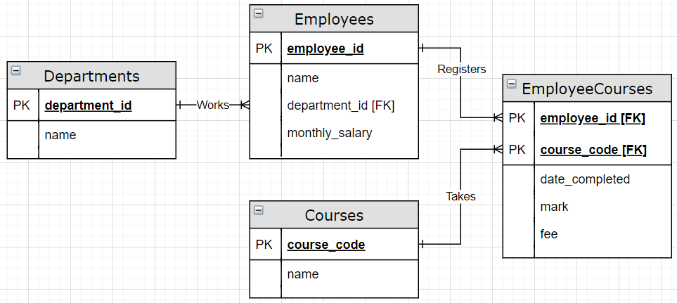
Database Normalization Example - ERD
Here is an ERD of the same tables.
Note: Some column names were changed to meet the standards we have been using in this course so far.

Slide 59
Database Normalization - Time Anomalies
Once in 3rd normal form, we want to check for Time Anomalies.
These happens when our tables are unable to handle data changes over time.
In our example, what is the current price of a course as of today’s date?

Slide 60
Database Normalization - Time Anomalies
Time Anomalies: What is the Current Price of a course?
We ‘might’ assume it is
the last value used when
someone registered for
a course.
The DB course was more recently paid for at $456.
But shouldn’t this course fee be in the Courses table?
EmployeeCourses
Emp ID | Code | Date Completed | Mark | Fee
100 | DB | 6/19/2020 | 78 | 456
100 | PV | 6/19/2020 | 88 | 330
140 | PC | 12/8/2020 | 91 | 700
140 | PJ | 1/30/2021 | 99 | 800
110 | DB | 5/7/2020 | 53 | 450
190 | PA | 6/19/2020 | 65 | 250
Courses
Code | Course
DB | Database
PV | VB
PC | C++
PJ | Java
PA | ASP

Slide 61
Database Normalization - Time Anomalies
Let’s add Fee to Courses; using the most recent values to populate it.
We cannot remove Fee from
EmployeeCourses because it is now
our historic prices over time.
Example:
Employee 100 paid $456 on 6/19/2020
Employee 110 paid $450 on 5/7/2020
Note: ‘Cost’ might be a better name than Fee??
Courses
Code | Course | Fee
DB | Database | 456
PV | VB | 330
PC | C++ | 700
PJ | Java | 800
PA | ASP | 250
EmployeeCourses
Emp ID | Code | Date Completed | Mark | Fee
100 | DB | 6/19/2020 | 78 | 456
100 | PV | 6/19/2020 | 88 | 330
140 | PC | 12/8/2020 | 91 | 700
140 | PJ | 1/30/2021 | 99 | 800
110 | DB | 5/7/2020 | 53 | 450
190 | PA | 6/19/2020 | 65 | 250

Slide 62
Normalization is key!
In our course:
All tables must be taken to 3rd normal form and time anomalies removed.
If you decide to step back and not remain in 3rd normal form it must be a conscious decision (in a workplace, you want to discuss this with the stakeholders carefully).
Not proceeding to 3rd normal form (missing something) will certainly cause problems later on...

Slide 63
Denormalization: Redundancy by design
Although we almost always want to normalize our databases, there are some reasons to Denormalize.
When done on purpose denormalizing can be used to improve the performance of database queries (shorten the database response time).
Example: Information can be duplicated into a smaller table with less columns and rows.

Slide 64
Normal Forms - Overview
First Normal (1NF)
Any repeating groups should be given their own row.
This may require a composite key (or surrogate) for the table.
Second Normal (2NF)
Non-key attributes dependent on part of a composite key
(partial functional dependency) to be move to a separate table.
Third Normal Form (3NF)
Fields with a derived dependency is removed
Non-key fields with a dependency on another non-key field
(transitive dependency) is moved to new table.

Slide 65
Anomalies - Overview
Insertion Anomaly
Data cannot be inserted into a table without inserting data
that is not directly related to the data being inserted.
Deletion Anomaly
When data is deleted, other data, not directly related to the
data being deleted is also lost.
Modification Anomaly
Modifying data requires multiple rows to be updated.
Time Anomaly
Data is either missing or inconsistent over time.

Slide 66
Dependencies - Overview
Functional Dependency
An attribute (ex: Employee Name) can be determined from another attribute in the same table (ex: Employee Number).
Partial Functional Dependency (2NF)
Non-key attribute(s) functionally dependent on part of a
composite primary key in the same table.

Slide 67
Dependencies - Overview
Derived Dependency (3NF)
Non-key attributes(s) calculated from other non-key
attributes in either the same table or in other tables.
Transitive Dependency (3NF)
Non-key attribute(s) functionally dependent on another
non-key attribute in the same table.

